Slide 1
Course Code: CSC211A Course Title: Formal Languages and Automata Theory
Lecture 29:Turing Machine-1
Course Leader:
Prakash P
prakashp.cs.et@msruas.ac.in

Slide 2
Session Objectives
At the end of this session, student will be able to
Explain the language hierarchy
Discuss a Turing machine
Explain states & transitions
Understand determinism
Explain partial transition function
Describe Turing machine example

Slide 3
Session Topics
The Language Hierarchy
A Turing Machine
States & Transitions
Determinism
Partial Transition Function
Turing Machine Example

Slide 4
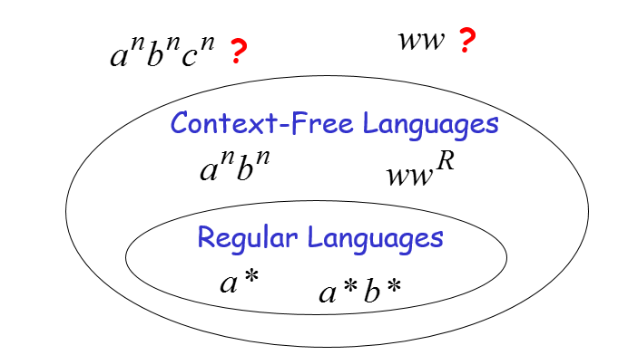
The Language Hierarchy

Slide 5
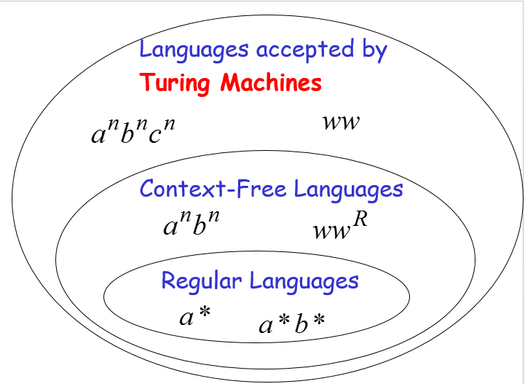
The Language Hierarchy

Slide 6
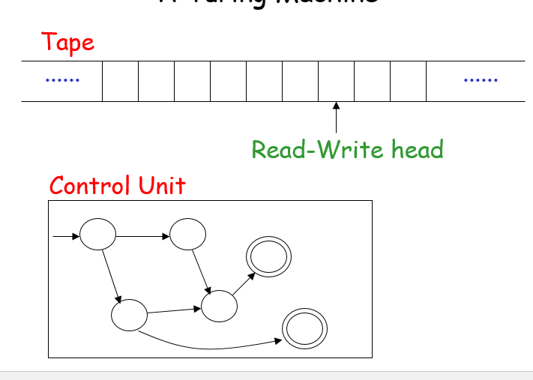
A Turing Machine

Slide 7
The Tape
No boundaries -- infinite length
......
......
Read-Write head
The head moves Left or Right

Slide 8
The Tape
......
......
Read-Write head
The head at each time step:
1. Reads a symbol
2. Writes a symbol
3. Moves Left or Right

Slide 9
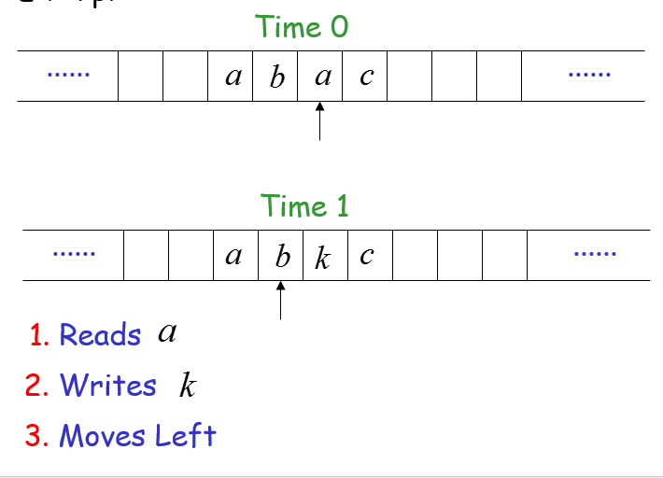
The Tape

Slide 10
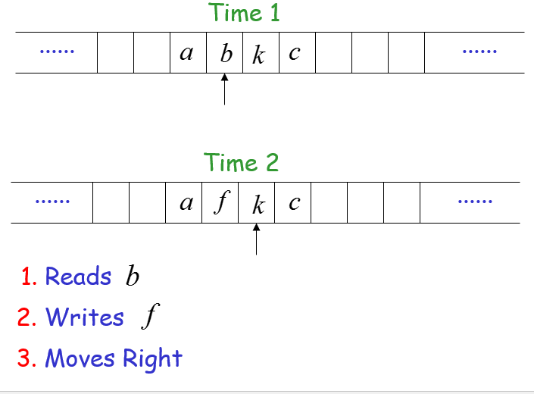
The Tape

Slide 11
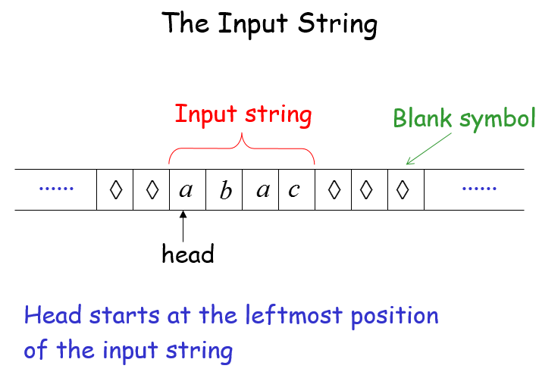
The Input String

Slide 12
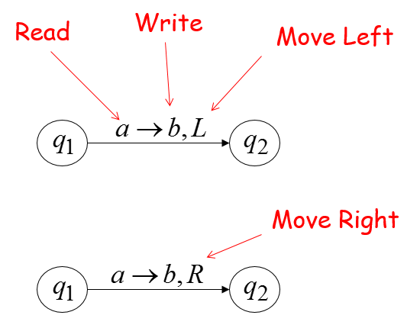
States & Transitions

Slide 13
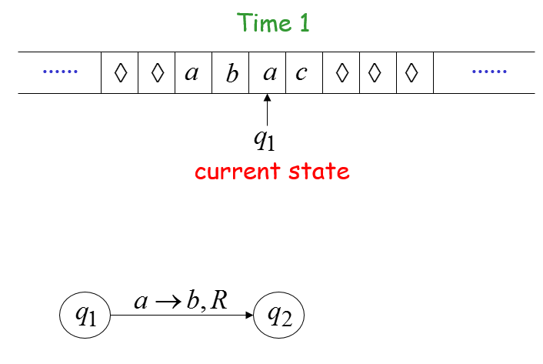
Example

Slide 14
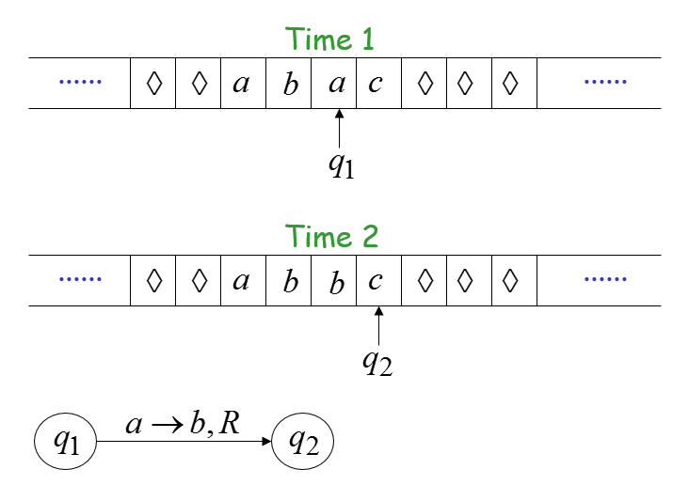
Example

Slide 15
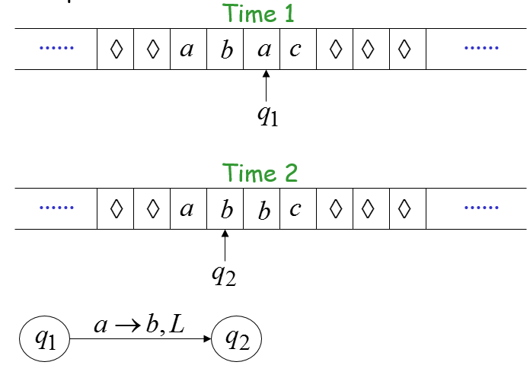
Example

Slide 16
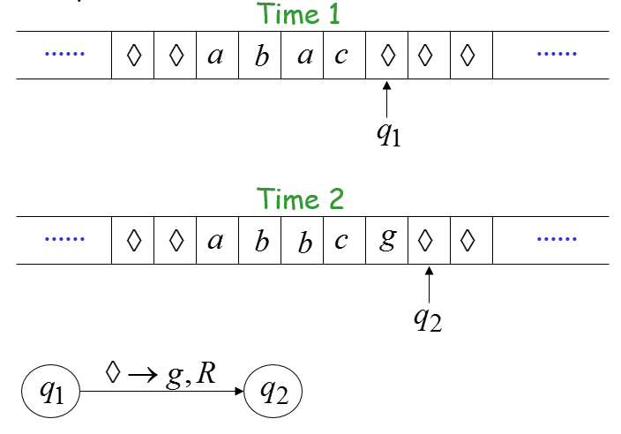
Example

Slide 17
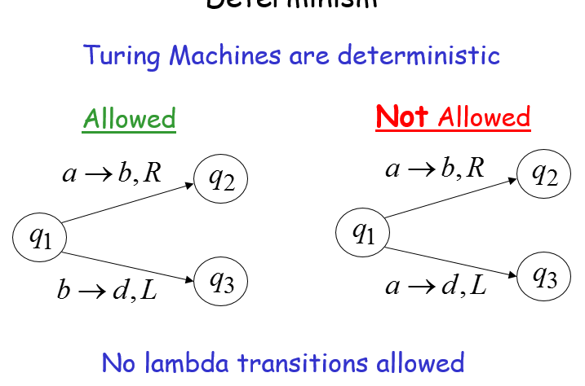
Determinism

Slide 18
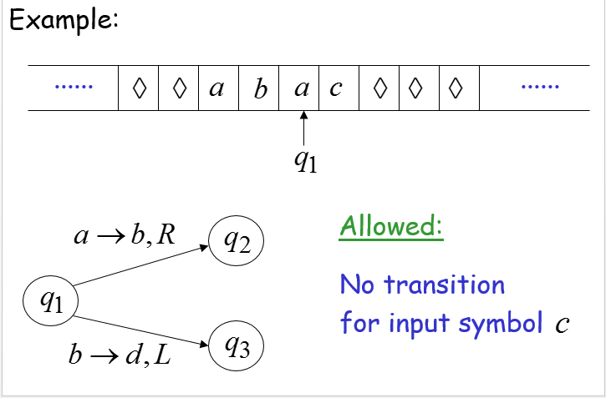
Partial Transition Function

Slide 19
Halting
The machine halts if there are no possible transitions to follow

Slide 20
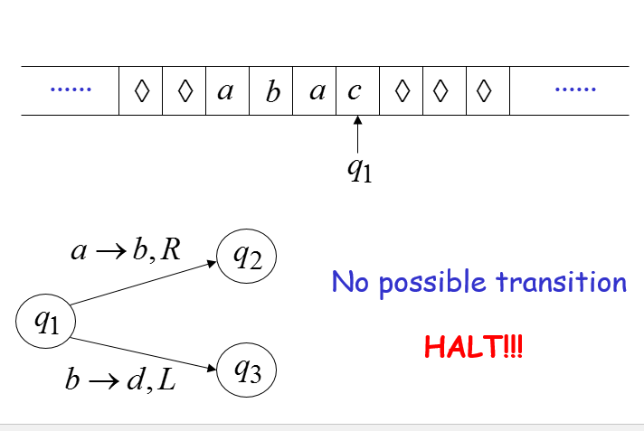
Example

Slide 21
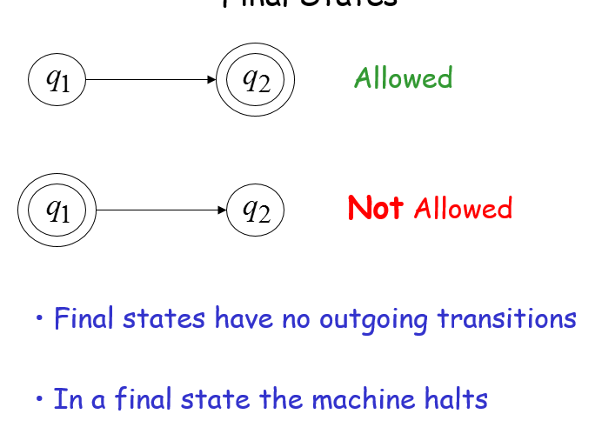
Final States

Slide 22
Acceptance
If machine halts
in a final state
Accept Input
If machine halts
in a non-final state
or
If machine enters
an infinite loop
Reject Input

Slide 23
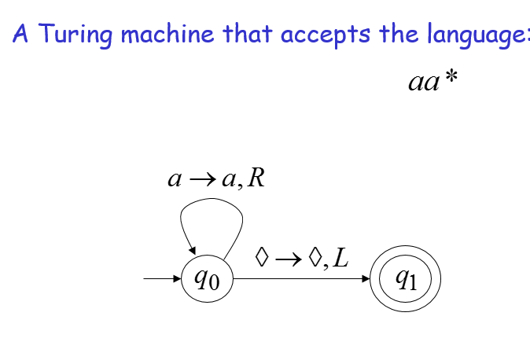
Turing Machine Example

Slide 24
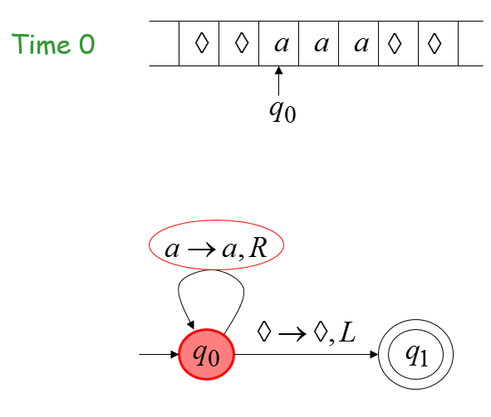
Example

Slide 25
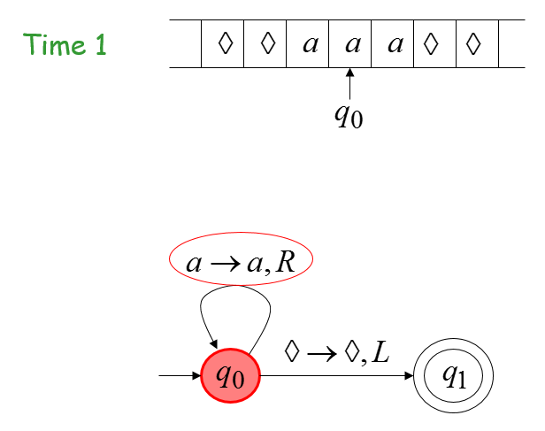
Example

Slide 26
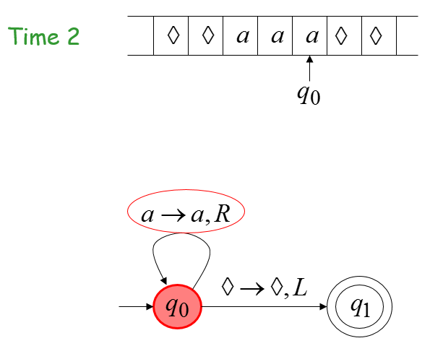
Example

Slide 27
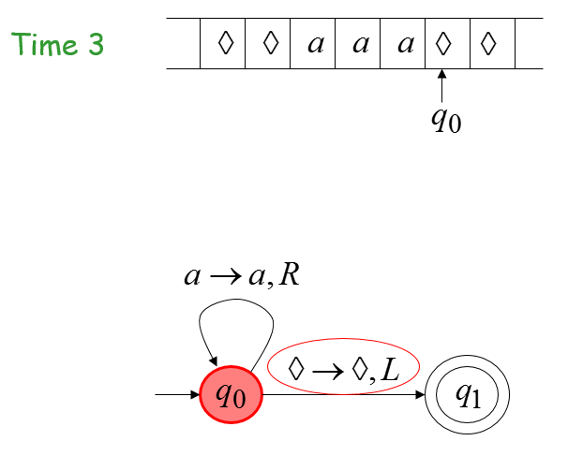
Example

Slide 28
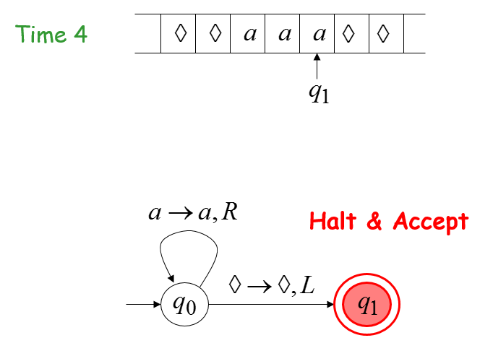
Example

Slide 29
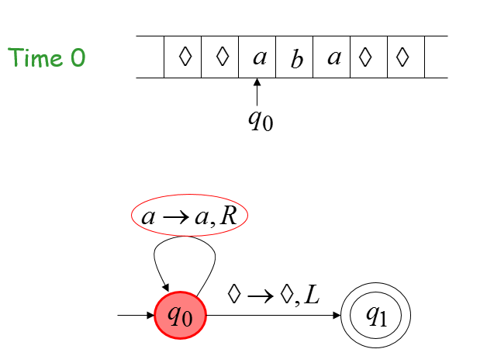
Example

Slide 30
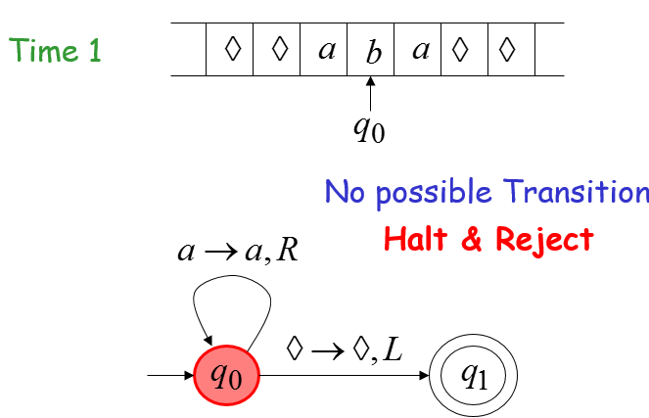
Example

Slide 31
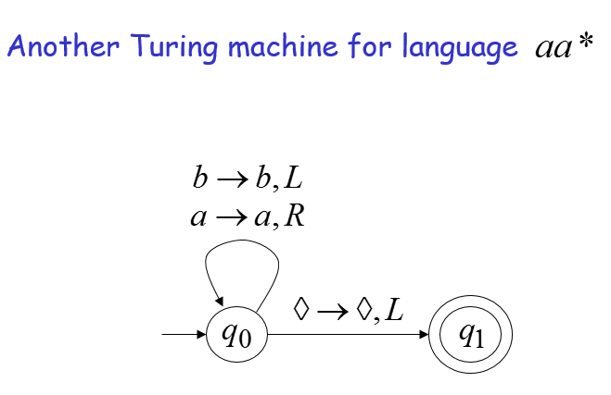
Infinite Loop Example

Slide 32
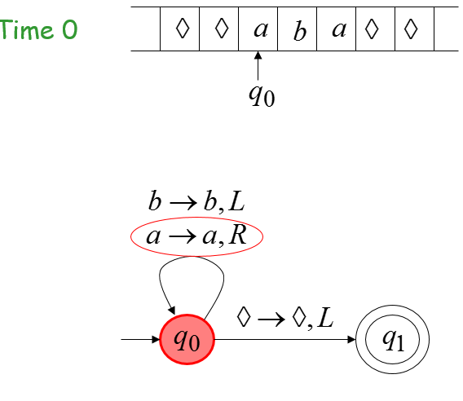
Example

Slide 33
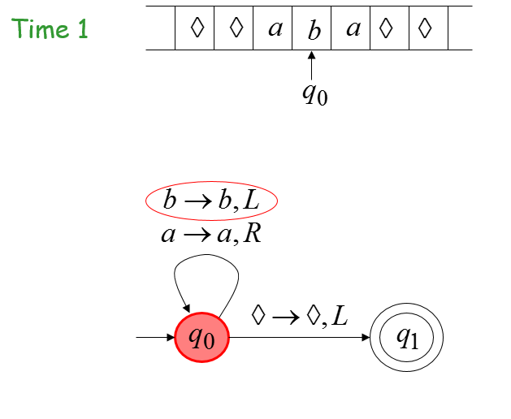
Example

Slide 34
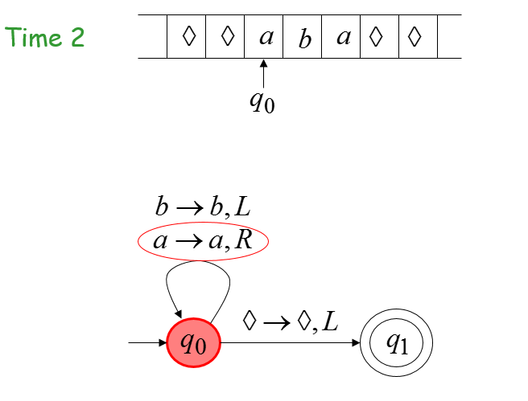
Example

Slide 35
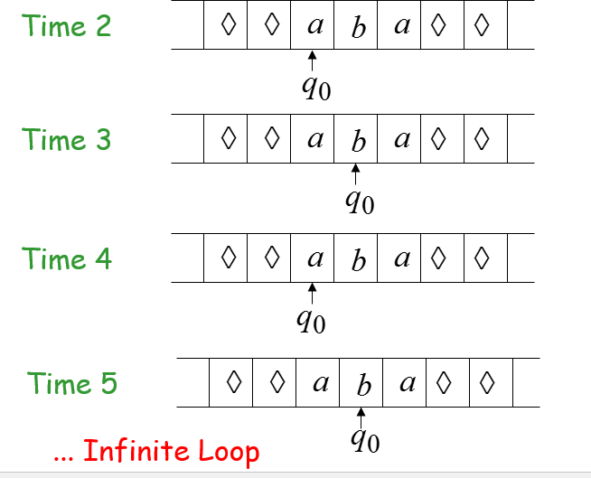
Example

Slide 36
Example
Because of the infinite loop:
The final state cannot be reached
The machine never halts
The input is not accepted

Slide 37
Summary
The head at each time step reads a symbol, writes a symbol, moves Left or Right.
The machine halts if there are no possible transitions to follow .
If machine halts in a final state if it accepts input.
If machine halts in a non-final state or If machine enters an infinite loop then it rejects input.

